Slide 1
Good morning

Slide 2
SALIVARY GLAND DISORDERS

Slide 3
CONTENTS
INTRODUCTION
ANATOMY OF SALIVARY GLANDS
FUNCTIONS OF SALIVA
CLASSIFICATION OF SALIVARY GLAND DISORDERS
IMAGING OF SALIVARY GLANDS
CONCLUSION
REFERENCES

Slide 4
Introduction.
The glands of the body is divided into:
Endocrine glands: do not possess any ducts or opening to the exterior.
Ex: Pituitary, Thyroid, Parathyroid, Adrenal, Pancreas, Ovaries, Testis.
Exocrine glands: which pass their secretions along ducts to the external surface of the body & glands of the mouth, stomach & intestines whose secretions are passed along ducts into the alimentary tract.
Ex: Sweat, Lacrimal, Mammary glands, Salivary glands.

Slide 5
The salivary glands are exocrine glands whose secretions flow into the oral cavity at a rate of 1000-1500ml/day.
There are three pairs of large salivary glands located extraorally and numerous small minor salivary glands widely distributed in the mucosa and submucosa of the oral cavity.
Sublingual gland
Parotid gland

Slide 6
The production of saliva is the most important function of salivary glands.
Saliva contains various organic & inorganic substances .
Provides the primary natural protection for the teeth & soft tissues of the oral cavity & assists in the mastication, deglutition & digestion of food.
Ducts of the glands

Slide 7
Flow of saliva is continuous in major salivary glands and intermittent flow in minor salivary glands.
Major & minor salivary glands are derived from stomodeal ectoderm.
These glands appear at 6th & 7th week of embryo.

Slide 8
Blood supply & Nerve supply
Parotid gland Submand gland Sublingual gland
Blood Supply Superficial temporal Facial & Lingual Lingual &
artery, Posterior arteries Submental arteries
auricular artery
Parasympathetic Postganglionic
nerves from otic parasympathetic
ganglion derived from sub
-mand ganglion
Sympathetic nerves Post ganglionic Post ganglionic
Nerve supply from plexus around sympathetic sympathetic
external carotid artery from superior from plexus around
cervical ganglion Facial & Lingual
arteries
Auriculotemporal & Sensory nerve from Sensory fibres from lingual
Greater auricular arteries Lingual nerve
(Branch of mand
div of trigeminal N)

Slide 9
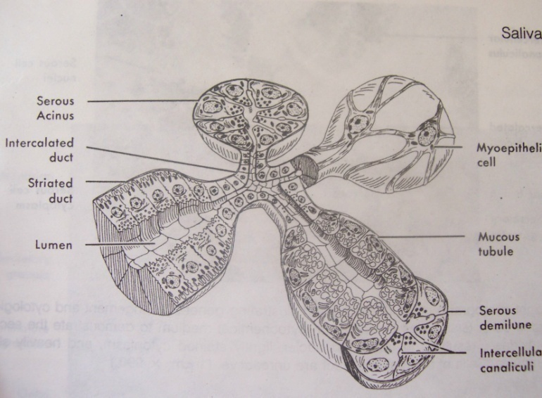
Microscopic anatomy
The functional unit of the salivary gland tissues is the alveolus or acinus.
Each acinus can be either mucous, serous or the combination of the two.
The acinus is a cluster of pyramidal cells.

Slide 10
Physiology of Saliva
The average daily saliva normally ranges for about 800-1500 ml at about a rate of 0.5 ml/min.
Composition of Saliva:
Saliva is composed of 99.5% water & 0.5% solids.
Solids include – cellular, inorganic, organic & gaseous constituents.

Slide 11
Functions of saliva:
Mechanical functions : Lubrication facilitates swallowing & speech
Digestive functions : Digests the cooked starch
Antibacterial functions : This function is mainly due to presence of lysosyme, peroxides & immunoglobulins IgG, IgA, IgM
Taste : Helps in sensing taste by dissolving the substances
Water balance : Stimulates salivary flow & feeling of thirst
Route of excretion : A route of excretion for various metal & harbours various viruses

Slide 12
CLASSIFICATION OF SALIVARY GLAND DISEASES
Developmental disturbances
A. Agenesis/Aplasia
B. Diverticuli
C. Atresia
D. Hyperplasia of palatal glands
E. Aberrancy
F. Developmental lingual mandibular salivary gland depression

Slide 13
II. Inflammatory conditions associated with salivary glands or sialadenitis
A. Bacterial sialadenitis
Acute & chronic
B. Viral sialadenitis
C. Allergic sialadenitis
D. Sarcoid sialadenitis
III. Salivary gland conditions associated with metabolic diseases.
Sialadenosis or sialosis

Slide 14
IV. Salivary gland conditions associated with autoimmune diseases
A. Mikulicz’s disease
B. Sjogren’s syndrome
V. Cysts associated with salivary glands
A. Mucous retention cyst
B. Mucous extravasation cyst
VI. Miscellaneous
A. Sialolithiasis
B. Necrotising sialometaplasia
C. Radiation induced salivary gland pathology

Slide 15
Salivary gland neoplasms
I. Adenomas
A. Pleomorphic Adenomas
B. Monomorphic Adenomas
Myoepithelioma
Basal cell adenoma
Warthin’s tumor
Oncocytoma
Canalicular adenoma
Sebaceous adenoma
Ductal papilloma
Intraductal papilloma
WHO 1991

Slide 16
Mucinous cystadenoma
Papillary cystadenoma
II. Carcinomas
Acinic cell carcinoma
Mucoepidermoid carcinoma
Adenoid cystic carcinoma
Epithelio myoepithelial carcinoma
Polymorphous low grade adenocarcinoma
Basal cell adenocarcinoma
Sebaceous carcinoma
Papillary cystadenocarcinoma

Slide 17
Malignant myoepithelioma
Oncocytic carcinoma
Mucinous adenocarcinoma
Carcinoma in pleomorphic adenoma
Adenocarcinoma
Squamous cell carcinoma
Small cell carcinoma
Salivary duct carcinoma
Others
III. Non epithelial tumors
IV. Tumor like lesions

Slide 18
Sialadenosis
Oncocytosis
Benign lymphoepithelial lesion
Necrotising sialometaplasia
Chronic sclerosing sialometaplasia of salivary gland
Salivary duct cyst
Cystic lymphoid hyperplasia in AIDS
V. Malignant lymphomas
VI. Secondary tumors

Slide 19
AGENESIS / APLASIA
Complete absence of salivary gland
Extremely rare condition
Any one gland or group of glands may be absent.
Unknown reasons or with other developmental defects such as hemifacial microsomia, LADD syndrome, mandibulofacial dysostosis, ectodermal dysplasia.
Patient with salivary gland aplasia experience Xerostomia, dental caries (rampant caries), burning sensation, oral infections, taste aberrations, difficulty in denture retention.
Others are enamel hypoplasia, congenital absence of teeth, extensive occlusal wear.

Slide 20
Diagnosis: excludings the common causes of xerostomia.
Investigations : CT & MRI –absence of glands replaced by fat & fibrous tissue.
Treatment : salivary substitutes,
anticaries agents,
sialogouges
oral hygiene procedures.

Slide 21
HYPOPLASIA
Hypoplasia of parotid gland has been associated with with Melkersson Rosenthal syndrome.

Slide 22
DIVERTICULI
Diverticuli is a pouch protruding from the walls of the duct , it often leads to pooling of saliva in the pouch and causes recurrent sialadenitis, may also lead to mucous retention cyst.
Asymptomatic.
In Darier’s disease patients have recurrent parotid gland swelling secondary to ductal abnormalities

Slide 23
Diagnosis:
by sialography, Ultrasound , CT, MRI.
Treatment :
no treatment is required .
surgical excision if cyst develops.
patients are encouraged for regular milking of the involved gland and promote salivary flow through the duct.

Slide 24
ATRESIA
Congenital occlusion or absence of one or more of the major salivary gland ducts.
Extremely rare condition.
Xerostomia, blockage of saliva leads to retention cyst.

Slide 25
HYPERPLASIA OF PALATAL GLANDS
Unusual localised hyperplasia of minor accessory salivary glands in the palate.
Factors causing are
endocrine disorders, gout, Diabetes mellitus, menopause, hepatic disease, starvation, alcoholism, inflammation, Sjogren’s syndrome, smoking, drugs & aging process.

Slide 26
Clinical features:
Presents as small localised swelling, 1mm or 1 cm or more in diameter, on hard palate or at the junction of hard & soft palate.
Are sessile, firm normal color.
Lesion asymptomatic
Treatment :
No specific treatment.

Slide 27
Aberrancy
The tissue that develop at unusual anatomic site .
commonly seen near the middle ear, external auditory meatus, neck, posterior mandible, anterior mandible.
Are incidental findings & require no treatment.

Slide 28
Developmental lingual mandibular salivary gland depression.
When the sub mandibular salivary gland sits with in the depression on the lingual posterior surface of the mandible (by STAFNE IN 1942)
It is located between the angle of the mandible and the first molar and below the level of inferior alveolar nerve
It is usually asymptomatic appears as an well circumscribed radiolucency on radiograph.
0.1-1.3%, predliction for males.
Less commonly anterior lingual submandibular salivary glands have been reported

Slide 29
ACUTE BACTERIAL SIALADENITIS
Also called acute suppurative parotitis.
Most cases occurs in adults but also affects children
Causes:
1. Microorganisms ( Staphylococcus aureus )
2. Other factors such as : drugs which decrease salivary flow( Tranquilizers, antidepressents, diuretics, antihistamines ).
3. Debilitated patients
4. Dehydration & poor oral hygiene.

Slide 30
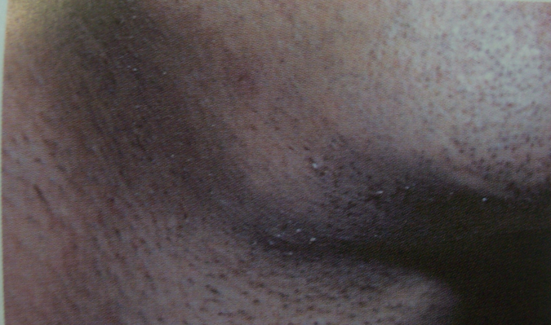
Clinical features :
affects older individuals
Usually unilateral ( 80 – 90 % )
Sudden onset of pain at the angle of the jaw & pain increases during eating & speaking
On examination: Tender, enlarged glands.
Overlying skin is characteristically warm & tender. The diagnosis is confirmed when purulent material is milked from stensen’s duct orifice by pressure over the gland.
Generalised symptoms are also present like fever, leukocytosis.

Slide 31
Treatment :
Discharge taken directly from the duct should be sent to the laboratory for culture & sensitivity.
Antibiotics ( Active against penicillin resistant staphylococcus)
If necessary, antibiotics can be changed when results of the culture & sensitivity are known. Fluids are given to maintain water & electrolyte balance.
Salivation should be stimulated by the sucking of sour hard candy to facilitate drainage.
Oral hygiene should be maintained by debridement & irrigation.
If there is no improvement , the affected gland should be surgically drained.

Slide 32
CHRONIC BACTERIAL SIALADENITIS
Chronic or recurrent form of parotitis is seen in children & adults.
Conditions which causes chronic parotitis are:
Most cases are idiopathic
Duct obstructions
Congenital stenosis
Sjogren’s syndrome
viral infection or allergy

Slide 33
Clinical features :
Sudden onset of unilateral swelling at the angle of the jaw in a patient
The symptoms are less when compared to acute bacterial parotitis.
Purulent discharge from the duct orifices .
Fever & leukocytosis are absent.

Slide 34
Treatment :
Fluids to maintain balance water & electrolyte
Massage of the gland
Antibiotics
Sialogogues
Intraductal injection of antibiotics (Erythromycin & Tetracycline 15mg/ml).
Surgical : Removal of the gland.

Slide 35
MUMPS
Caused by paramyxovirus
It primarily affects the salivary glands but also affects the gonads, central nervous system & occasionally the thyroid gland, pancreas & myocardium.
Common during the second decade of life.

Slide 36
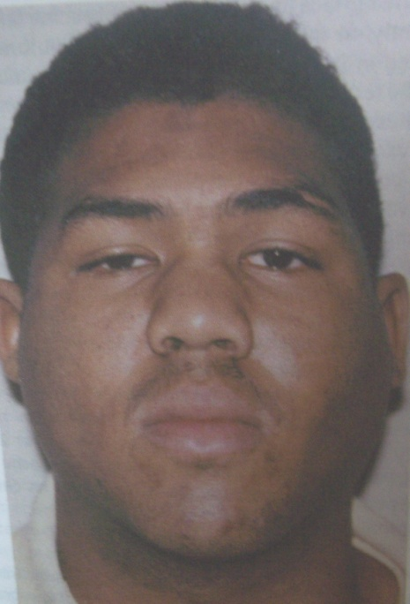
Clinical features :
The major sign of mumps is sudden onset of salivary gland bilateral swelling without purulent discharge from the salivary gland ducts.
Accompanied by generalised signs of fever, malaise & anorexia.
In most cases parotd gland is involved & some
times submandibular gland may be involved.
Characteristically, the involved salivary gland continues to enlarge for 2-3 days & returns to normal size in 7 days.

Slide 37
The enlarged glands are tender .
Pain is experienced when eating sour food.
Salivary gland enlargement accompanied by oedema of the skin over the glands & inflammation around stensen’s or wharton’s duct orifice.
Most cases of mumps are self-limiting, enlargement subsides within 1 week.

Slide 38
Complications :
1. Meningitis
2. Encephalitis
3. In post pubertal males it involves gonads & causes
sterility.
Investigations :
1. Culture of virus
2. Detection of antibodies
3. During acute phase, the serum amylase level may be
elevated.

Slide 39
Treatment :
Most of the cases are self limiting
Symtomatic treatment
The best method of controlling this disease is by giving vaccination
Corticosteroids are helpful in treating painful testicular involvement.

Slide 40
ALLERGIC SIALADENITIS
Allergic reaction to drugs or other allergens cause salivary gland enlargement.
The occurrence of this enlargement is rare.
Clinical features :
Bilateral acute swelling of the parotid glands & associated signs are skin rashes, angioedema.
The characteristic feature of allergic reaction is acute salivary gland enlargement, often accompanied by itching over the gland.

Slide 41
May develop chronic salivary gland infections.
Compounds having salivary gland enlargement as a potential side effect include phenobarbital, phenothiazine, ethambutol, sulfisoxazole, iodine compound and heavy metals.
Treatment:
Is self limiting.
Avoiding the allergens,
maintain hydration and
monitoring for secondary infection are recommended

Slide 42
Necrotizing sialometaplasia
Necrotizing sialometaplasia (NS) is a non - neoplastic, self limiting, reactive inflammatory condition of the salivary glands.
In 1973, Abrams et al first reported this condition.
The clinical and histopathologic features of Necrotizing sialometaplasia often simulate those of malignancies such as squamous cell carcinoma or mucoepidermoid carcinoma.
In most cases of Necrotizing sialometaplasia , the etiology is believed to be related to vascular ischemia that lead to local infarction.

Slide 43
Predisposing factors:
traumatic injury
Dental injections
Ill fitting denture
Upper respiratory tract infection
Previous surgery
Adjacent tumours
Vomiting episodes in bulimia
Tobacco usage

Slide 44
Clinical features:
develop in palatal salivary gland
75% of cases occur in posterior part of the palate
Mostly unilateral ,
Common in adults
Mean age is between 46 yrs, males are more commonly affected
It appears as non ulcerated swelling associated with pain or paresthesia with in 2-3 wks
Necrotic tissue sloughing leaving a crater like ulcer that can range from 1cm to more than 5cm in diameter
Patient complaints of “ part of my palate is fallen out”

Slide 45
Differential diagnosis
Squamous cell carcinoma
Mucoepidermoid carcinoma
Malignant minor salivary gland neoplasms
Syphilitic gummas
Deep fungal infections

Slide 46
Treatment
Is self limiting.
Healing takes place over a period of 5-6 sweeks with secondary intention.
Regular irrigation of the wound
Use of Antiseptic mouth rinses.
Periodic evaluation until complete resolution.

Slide 47
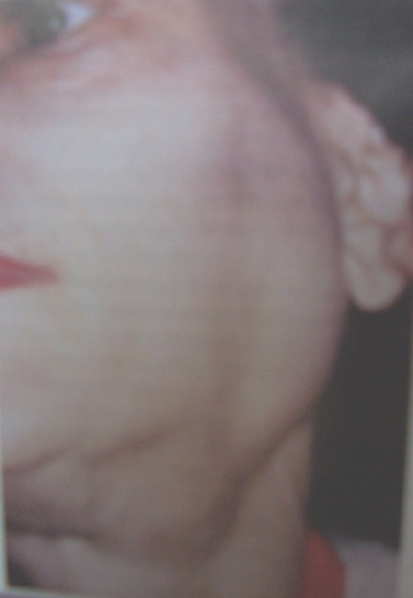
Sialadenosis
The sialadenosis ( sialosis ) are characterized by a non-neoplastic , non inflammatory enlargement of salivary glands.
The cause of the sialadenosis is unknown.
Usually bilateral & painless enlargement.
Parotid glands are more commonly affected.
usually attributed to fatty infiltration.

Slide 48
Histopathology :
Shows acinar hypertrophy.
Edema of the interstitial supporting tissue .
Atrophy of the striated ducts & fatty infiltration.
Excessive accumulation of secretory granules in the cytoplasm of acinar cells.
Alteration in chemical constituents of the saliva :
Elevation of salivary potassium.
Decrease in salivary sodium.

Slide 49
Classification of sialadenosis
Hormonal sialadenosis
-sex hormonal sialadenosis
-diabetic sialadenosis
-thyroid sialadenosis
-hypophyseal & adrenal cortical sialadenosis
Neurohormonal sialadenosis
-peripheral neurohormonal sialadenosis
-central neurogenous sialadenosis

Slide 50
Dysenzymatic sialadenosis
- hepatogenic sialadenosis
- pancreatogenic sialadenosis
nephrogenic sialadenosis
Malnutritional sialadenosis
Drug induced sialadenosis

Slide 51
Conditions associated with sialadenosis.
Endocrine
-Diabetes mellitus
-pregnancy
-hypothyrodism
-acromegaly
Nutritional
-general malnutrition
-alcoholism
-anorexia nervosa
-bulimia

Slide 52
Neurogenic medications
-antihypertensive drugs
-psychotropic drugs

Slide 53
Treatment
Treating the Underlying cause
Partial paritidectomy.
Pilocarpine effective in few cases.

Slide 54
SIALOLITHIASIS
Sialoliths are calcified matter that develop in the parenchymal or ducts of the major or minor salivary glands.
Chemical composition :
Sialoliths are crystalline and composed of hydroxyapetite crystals, chemical composition of octa calcium phosphate and carbon with traces of magnesium, potassium chloride and ammonium.

Slide 55
Etiology :The exact etiology is still debated.
But several factors play a significant role .
These include: Inflammatory
Local irritants
Drugs that cause stasis leading to build up an organic nidus that calcifies .

Slide 56
Site :
80% - 90% occurs in submandibular gland or duct for the following reasons :
Wharton’s duct contains sharp, curves likely to trap mucus plugs or cellular debris .
Calcium levels are higher in saliva from submandibular gland.
The dependent position of the submandibular gland increases the chances for stasis.
5% to 15% sialoliths occurs in parotid gland .
2% to 5% in sublingual & minor salivary galnds

Slide 57
Clinical features :
Painful intermittent swelling in the area of a major salivary gland, which worsens during eating & resolves after meals.
The pain originates because of back up of saliva.
The stasis may lead to infection, fibrosis & atrophy of glandular parenchyma.
Sialoliths can be palpable if present in the peripheral portion of the duct.

Slide 58
The involved gland is usually tender and enlarged
On examination soft tissue surrounding the duct may show sever inflammatory reaction.

Slide 59
Complications from Sialoliths include
acute sialadenitis,
ductal strictures,
ductal dilation,
fistulas,
sinus tracts and
ulceration of the surrounding areas in chronic cases

Slide 60
Investigations :
Periapical or occlusal x-ray
placed inside the mouth in the region of the duct.
Lateral oblique view is also helpful.

Slide 61
Sialography remaining the best method of visualizing the ductal system & in the diagnosis of stones that cannot be palpated clinically or visualized by routine films.
But use of this invasive technique is decreasing & replaced by ultrasound or computerized axial tomograph or scan, which are excellent non-invasive methods of detecting calcified stones.

Slide 62
Treatment :
Acute infections secondary to stasis should be treated with antibiotics, analgesics, and antipyretics .
Some stones can be removed manually.
Deeper stones require surgery.
Lithotripsy as been used as a non-invasive method of disintegrating sialoliths.

Slide 63
Stones at or near the orifices of the duct can be removed by milking the gland
Location with in the duct determines the type of surgery required for removal of the stones, if the stone is present in the intra glandular portion of the duct entire portion of the gland should be excised

Slide 64
Recurrent post obstructive sialadenitis after failed intra oral stone extraction usually is treated with sialadenectomy .
Several new techniques have recently become available to treat sialolithiasis and salivary duct stenosis by way of an intraluminal approach and include extra corporal sialolithotripsy, endoscopic stone removal, lithotripsy, and endoluminal balloon dilatation.

Slide 65
MUCOCELE
Mucocele is a common lesion of the oral mucosa the results from the rupture of salivary gland duct and spillage of mucin in to the surrounding soft tissue.
Mucocele is not a true cyst because it lacks the epithelial lining.
Swelling caused by the pooling of saliva at the site of minor salivary gland duct.

Slide 66
Mucoceles can be divided into:
Mucus extravasation type – Lacrimation of minor salivary gland duct by trauma, saliva leaks into the submucosal tissues causing pooling of mucus.
Mucus retention type – Caused by obstruction of a minor salivary gland duct which causes back up of saliva. This continual pressure dilates the duct & forms a cyst like lesion.

Slide 67
Clinical features :
Majority occurs on lower lip but it may present on floor of the mouth, tongue & palate.
Mucus extravasation type : Common on lip
Mucus retention type : Common in floor of the mouth & palate.
Usually they are asymptomatic.( small lesions sometimes confused with vesiculobullous lesions )
Superficial lesions appears as thin walled, bluish lesions that rupture easily; they resemble bullae.

Slide 68
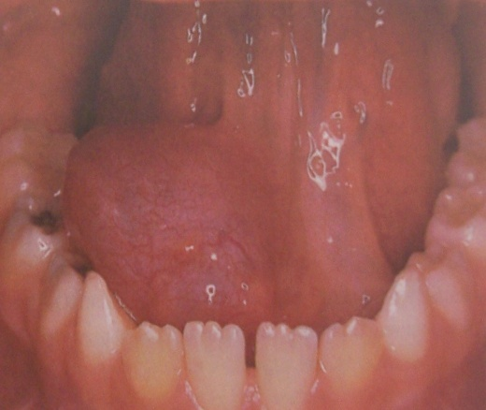
Mucocele

Slide 69
They range from 3-4 mm to more than 1 cms in diameter.
Deeper lesion swellings covered by normal appearing mucosa.

Slide 70
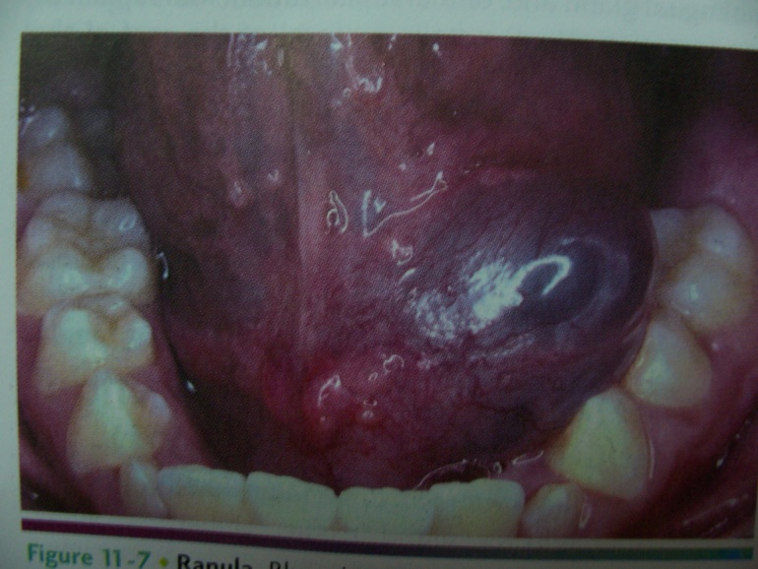
A special type of mucocele is the RANULA which occurs on floor of the mouth from trauma of a sublingual & submandibular gland duct.
They resemble to the belly of a
frog ( named after ).
They are soft & freely movable.

Slide 71
The ranulas appear as blue dome shaped swellings in the floor of the mouth
Deeper portions may be normal, ranula tend to be larger than mucocele
They can develop in to larger masses that are many centimeters in diameter, fill in the floor of the mouth and elevate the tongue.
Plunging ranula occurs when the spilled mucin dissects through the mylohyoid muscle and producing swelling with in the neck
Tail sign is the classical feature and pathognonic feature of plunging ranula in CT it shows small longitudinal tail like extension of pseudo cyst.

Slide 72
Treatment :
Surgical removal of the lesions
Large ranulas managed by marsupialisation
Intralesional injection of corticosteroid solution.

Slide 73
Sjogren’s syndrome
Sjogrens syndrome was first described by Henrick Sjogrens in year 1933.
In 1930, Sjögren observed his first cases of keratitis sicca and began a systematic study of the disease that lasted more than 20 years. In his landmark publication, he named the disorder keratoconjunctivitis sicca. Sjögren published so extensively that by 1936, the entity was referred to as Sjögren syndrome.
It is a chronic auto immune disease characterized by symptoms of ocular and oral dryness and lymphocytic infiltration and destruction of the exocrine gland .

Slide 74
It effects women over the age of 40 years and the second most auto immune disease, with an estimated prevalence of 1-3% of world’s population
The effects on the eye are called as Kerato conjunctivitis sicca (sicca=dry)

Slide 75
Clinical presentation of both xerostomia and xeropthalmia are called as sicca complex
Majority of the patient with Sjogrens syndrome have symptoms related to diminished lacrimal and salivary gland function
Initial manifestation can be mucosal dryness, 8-10 yrs elapse from the initial symptom to full blown development of the disease

Slide 76
Pathophysiology
The path physiology of SS is not well understood.
A genetic predisposition exists for the disease, and, interestingly, the genetic association varies among ethnic groups.
In white persons, for instance, a linkage exists to human leukocyte antigen (HLA)–B8, HLA-Dw3, and HLA-DR3;
whereas the linkage is to HLA-DRw53 in Japanese persons and to HLA-DR5 in Greek and Israeli persons.
Some evidence indicates that the true association of SS may be with HLA-DQA1, which is in linkage disequilibrium with HLA-DR3 and HLA-DR5.

Slide 77
Histocompatibility complex (MHC) class II molecules are expressed at high levels on salivary gland epithelial cells.
cytokines are also over expressed in patients with SS.
Therefore, these salivary gland epithelial cells that express MHC class II molecules could conceivably act as antigen-presenting cells to CD4⁺ T cells, which then infiltrate the salivary gland and subsequently interfere with its normal glandular function.

Slide 78
Although more in the minor salivary gland because of its accessibility.
Another feature of SS is hyper gammaglobulinemia and auto antibody formation, especially antinuclear antibody (ANA) and rheumatoid factor (RF). This may be due to polyclonal B-cell activation.

Slide 79
Hormones level in Sjogrens syndrome:
Increase level of prolactin
Significantly higher prolactin/ Progesterone ratio
Increase estrogen/ Progesterone ratio
Prolactin is a hormone that is secreted from the pituitary glands is been shown to be elevated in auto immune disorders
It stimulates macrophages and play a role in macrophage tissue depletion, it shares many properties with cytokines and play a role in the pathogenesis of auto immune disease.

Slide 80
Ocular involvement
Ocular involvement include, patient complaints of dry eyes, with a gritty feeling under the eye lids, burning sensation, accumulation of thick strands at the inner canthi, tearing redness, itching, eye fatigue and increase photosensitivity .
These are due to destruction of bulbar and corneal conjunctival epithelium defined as keratosis conjunctiva sicca
Irregularity of the corneal image may be present.

Slide 81
Staining with vital dyes (rose Bengal or lissamine green)--The tests show how much damage dryness has done to the surface of the eye.
The doctor puts a drop of a liquid containing a dye into the lower eye lid.
These drops stain on the surface of the eye, highlighting any areas of injury.

Slide 82
Schirmer test--This test measures tears to see how the lacrimal gland is working.
It can be done in two ways:
In Schirmer I, the doctor puts thin paper strips under the lower eyelids and measures the amount of wetness on the paper after 5 minutes. People with Sjogrens usually produce less than 8 millimeters of tears.

Slide 83
The Schirmer II test is similar, but the doctor uses a cotton swab to stimulate a tear reflex inside the nose.
Sjögren's antibodies, called SS-A (or SS-Ro) and SS-B (or SS-La), are specific antinuclear antibodies common in people with Sjögren's. However, you can have Sjögren's without having these ANAs.

Slide 84
Primary SS - Characteristic signs and symptoms (above) without associated autoimmune disease
Secondary SS - Same as primary SS plus the presence of rheumatoid factor, SLE, polymyositis, scleroderma, or biliary cirrhosis

Slide 85
EUROPIAN CLASSIFICATION
Ocular symptoms: dry eyes every day more than three months
Recurrent sensation of sand or gravel in the eye or use of tear substitute more than three times a day
Oral symptoms: Daily feeling of dry mouth for more than three months
persistent swollen salivary glands
use of liquid to aid in swallowing dry foods

Slide 86
Ocular sign: positive Schrimer test (< 5mm in 5 minutes)
Salivary gland: positive result in one of the following test (salivary scintigraphy, parotid sialography, salivary flow (<1.5ml in 15 minutes)
Auto antibodies: antibodies to Ro (SS-A) or LA (SS-B) antinuclear antibodies or Rheumatoid factor

Slide 87
San Diego classification for Sjogren’s syndrome.
Ocular symptoms - Symptoms of ocular dryness
Ocular signs - Positive Schirmer test (<8 mm in 5 min) and positive rose Bengal staining of the cornea
Oral symptoms - Symptoms of oral dryness
Histopathologic findings - Abnormal biopsy findings in a minor salivary gland (focus score >2 in an average of 4 lobules)

Slide 88
Salivary gland involvement –
Decreased parotid flow rate (eg, Lashley cups)
Serologic or auto antibody test results :
Serologic evidence of systemic autoimmunity, rheumatoid factor >1:320 or antinuclear antibody (ANA) level > 1:320 or positive result for SS-A (Ro) or SS-B (La) antibodies

Slide 89
Histopathologic findings - Abnormal biopsy findings in a minor salivary gland (focus score >2 in an average of 4 lobules)
Salivary gland involvement :
Decreased parotid flow rate (eg, Lashley cups)
Serologic or autoantibody test results –
Serologic evidence of systemic autoimmunity, rheumatoid factor >1:320 or antinuclear antibody (ANA) level > 1:320 or positive result for SS-A (Ro) or SS-B (La) antibodies

Slide 90
Categories
Definite - Objective evidence of dry eyes and/or mouth, autoantibody presence, and characteristic results from minor salivary gland biopsy
Probable - Same as the above, but results from minor salivary gland biopsy not required
Primary SS - Characteristic signs and symptoms (above) without associated autoimmune disease
Secondary SS - Same as primary SS plus the presence of rheumatoid factor, SLE, polymyositis, scleroderma, or biliary cirrhosis.

Slide 91
HIV infected Sjogrens syndrome:
Predominant in young males
Lack of auto antibodies to RO/SS-A and La/SS-B
Lymphoid infiltration is seen with predominant CD8⁺ lymphocytes
It is associated with HLA-DR5
positive serological test for HIV

Slide 92
MIKULICZ’S DISEASE (MD)
It is also called as benign lympho epithelial lesion
MD was first described in 1937 as a benign, a symptomatic symmetrical enlargement of the lacrimal and salivary gland
The condition is thought to be a variant of a larger symptom complex , Sjogrens syndrome because their pathologic characteristic are similar
Both the condition are characterized by dense infiltration with lymphocytes of salivary and lacrimal gland
According to the criteria of Schaffer and Jacobsen MD is of unknown etiology and follows a benign course
Mikulicz’s syndrome is associated with some other disorders such as leukemia, lymphosarcoma, tuberculosis and sarcoidosis

Slide 93
The treatment is palliative, the possibility of neoplastic transformation is a concern
The detection of monoclonal lymphocytic infiltrate is thought to be suggestive of low grade lymphoma
Treatment is controversial; some clinician advocate irradiation therapy where as others recommend monitoring when the disease is limited to the salivary gland

Slide 94
SIALORRHOEA
Also called as ptyalism
Local:
Herpes stomatitis
ANUG
Pharyngitis
Apthous ulcers
Eruption of teeth
Neurologic:
Parkinsonism
Epilepsy
Mental retardation

Slide 95
Increase flow rate: Acrodynia
Rabies
Familial Dysautonomias
Ptyalism is often classified as acute or chronic ptyalism
Acute ptyalism:
Epiglottitis
Neoplasia or presence of a tumor
Presence of an abscess

Slide 96
Minor sialorrhea may result from local irritants, such as apthous ulcers or ill fitting dentures
Patients with new denture often experience excessive salivation until they become accustomed to the prosthesis
Episodic hyper secretion of saliva or water bash may occur as a protective buffering system to neutralize stomach acid in individuals with gastro esophageal reflux disease

Slide 97
Clinical features:
the excessive saliva production typically produces drooling and choking, which may cause social embarrassment.
In children with mental retardation or cerebral palsy, the uncontrolled salivary flow may lead for macerated sores around the mouth, chin and neck that can become secondarily infected.
An intensity type of super salivation of unknown cause has been termed idiopathic paroxysmal sialorrhea, individuals with this condition experience short episodes of excessive salivation lasting from 2-5 minutes

Slide 98
These episodes are associated with prodome of nausea or epigastric pain
Treatment and prognosis: for individuals with increased salivation associated with gastro esophageal reflux disease, medical management of their reflux problem may be beneficial
For persistent severe drooling therapeutic intervention may be indicated
Anti cholinergic medication can decrease saliva production but may produce un acceptable side affect

Slide 99
Trans dermal scopolamine has been tried with some success, but it should not be used in children younger than 10yrs
Speech therapy can used to control neuro muscular control
Several surgical techniques have been used successfully to control drooling in individuals with poor neuro muscular control

Slide 100
XEROSTOMIA
Xerostomia is defined as a subjective complaint of dry mouth that may result from a decrease in the production of saliva
Xerostomia is an uncomfortable condition and a common oral complaint from which patients may seek relief from dental practitioners
Xerostomia is the most common long- standing problem for the majority of affected patients

Slide 101
ETIOLOGY
Radiation therapy
Primary Biliary Cirrhosis
Vasculitis
Chronic Active Hepatitis
Bone Marrow transplantation
Renal dialysis
Diabetes type I & II
Anxiety or Depression
Graft Versus host disease
Cystic fibrosis
HIV Disease

Slide 102
Effects of long standing xerostomia
Increased frequency of caries(cervical caries)
Dysphagia
Dry, sore ,cracked lips
Burning , depapillated tongue.
Salivary gland enlargement
Oral mucosal sores
Dysgeusia
Candidal infections gingivitis

Slide 103
Management of xerostomia
Topical agents:
Treatment of dry mouth has focused on palliative measures with salivary substitutes, because these are removed from the mouth during swallowing the duration of their effect is short and they also lack the protective roles of saliva
Saliva substitutes function in improving lubrication and hydration of oral tissue

Slide 104
Sugar free gums or sugar free candies may help to increase salivary out put, but they may be inconvenient and affects patient compliance
Lubricating agents in the form of gels, mouth washes, lozenges and tooth paste have been used
In a recent therapy a mucin spray was found to be useful against xerostomia in those who had undergone radiation
An intra oral device containing saliva substitute and slowly releasing the lubricant in to the mouth has proved more acceptable to patients with xerostomia.

Slide 105
Systemic agents
Cholinergic Drugs:
Pilocarpine: it is a parasympathetic agonist of acetylcholine Muscarinic M3 receptor and stimulates the secretion of exocrine glands like sweat, lacrimal, salivary and respiratory mucosa.
Pilocarpine is readily absorbed from the gastrointestinal tract and peak plasma concentration are reached with in approx. 1hr. Pilocarpine is metabolized in the liver and excreted by means of kidney with half life being 1hr
Cholinergic drugs stimulate acetyl choline receptors of major salivary gland

Slide 106
Typical adverse effect are sweating, head ache, nausea, mild abdomen pain, urinary frequency, influenza like symptoms, rhinitis, flushing, increased lacrimation and palpitations.
Radiation induced xerostomia:
The optimal dosage of Pilocarpine is 5mg 4 times daily or 10mg 3 times daily, it should be prescribed for at least 8-12 weeks
The pilocarpine induced enhanced salivary secretion may be possible for up to 7 mths after radiation
It has been suggested that the administration of pilocarpine before or during the radiation may lessen the severity of any radiation induced xerostomia

Slide 107
It protect the kidneys against the harmful effects of the cancer-fighting drug in patients with ovarian cancer or lung cancer
Amifostine administered intravenously before radiation may lessen the severity of radiation induce xerostomia (500mg )
Sjogrens syndrome: systemic pilocarpine increase salivary flow rate with in 2-3 hrs of administration and reduce symptoms of xerostomia
A dosage of 5mg of pilocarpine 4 times daily for at least 12 weeks is beneficent, un stimulated salivary flow significantly increase 1 hr after the administration of 5mg of pilocarpine

Slide 108
Graft versus Host: oral pilocarpine 30mg/day can alleviate GVHD- induced xerostomia and improve the flow rate from the major salivary gland
Drug Induced xerostomia: there are few reports in the management of drug induced xerostomia
Yohimbine had been shown to have a sialogenic effect on drug induced dry mouth
Bethanechol: it has both Muscarinic and nicotinic agonist action
Dosage of 25mg, 3 times daily was found to increase un stimulated and stimulated salivary flow, adverse affect include diarrhea and nausea

Slide 109
Cevimeline: it is a quinuclidine analog of acetylcholine with a high affinity for M3 receptors but a low affinity for M2 receptors on cardiac and lung
Metabolized in the liver and excreted through kidney and half life of approx. 5hrs
Daily dosage of 30mg 3 times daily dosage is than pilocarpine, it is well tolerated and provide substantive relief of xerostomia
Carbacholine: it is affective in the treatment of radiation induced xerotomia

Slide 110
Anethole Trithone: it has no cholinergic action, it increase the availability of Muscarinic receptor on the post synaptic membrane and enhance the potential for cholinergic stimulation
It is used in radiation induced xerostomia
Pyridostigmine: it is a cholinesterase inhibitor with both nicotinic and Muscarinic agonist activity
Placebo controlled study suggest that it may be useful in the treatment of drug induced xerostomia
Bromhexine: (32-48mg daily) increases salivary and lacrimal flow rate in patients with Sjogrens syndrome

Slide 111
TUMORS OF SALIVARY GLANDS

Slide 112
INTRODUCTION
Salivary gland neoplasm make up 1% of all head and neck tumors.
Salivary gland neoplasm most commonly appear in the sixth decade of life.
Patients with malignant lesions typically present after age 60 years, whereas those with benign lesions usually present when older than 40 years.
Benign neoplasm occur more frequently in women than in men.
Malignant tumors are distributed equally between the sexes.

Slide 113
Most series report that about 80% of parotid neoplasm are benign.
The most common tumor of the parotid gland is the pleomorphic adenoma which represents about 60% of all parotid neoplasm.
Salivary gland neoplasm are rare in children.
In children 35% of salivary gland neoplasm are malignant.
Muco epidermoid carcinoma is the most common salivary gland malignancy in children.

Slide 114
Salivary gland neoplasms
I. Adenomas
A. Pleomorphic Adenomas
B. Monomorphic Adenomas
Myoepithelioma
Basal cell adenoma
Warthin’s tumor
Oncocytoma
Canalicular adenoma
Sebaceous adenoma
Ductal papilloma
Intraductal papilloma
WHO 1991

Slide 115
Mucinous cystadenoma
Papillary cystadenoma
II. Carcinomas
Acinic cell carcinoma
Mucoepidermoid carcinoma
Adenoid cystic carcinoma
Epithelio myoepithelial carcinoma
Polymorphous low grade adenocarcinoma
Basal cell adenocarcinoma
Sebaceous carcinoma
Papillary cystadenocarcinoma

Slide 116
Malignant myoepithelioma
Oncocytic carcinoma
Mucinous adenocarcinoma
Carcinoma in pleomorphic adenoma
Adenocarcinoma
Squamous cell carcinoma
Small cell carcinoma
Salivary duct carcinoma
Others
III. Non epithelial tumors
IV. Tumor like lesions

Slide 117
Sialadenosis
Oncocytosis
Benign lymphoepithelial lesion
Necrotising sialometaplasia
Chronic sclerosing sialometaplasia of salivary gland
Salivary duct cyst
Cystic lymphoid hyperplasia in AIDS
V. Malignant lymphomas
VI. Secondary tumors

Slide 118
Tumors from ductal system
Intercalated duct
-pleomorphic adenoma
-monomorphic adenoma
-acinic cell carcinoma
-adenoid cystic carcinoma
-Epithelio myoepithelial carcinoma
-Polymorphous low grade adenocarcino
Straited duct
-warthin’s tumour
-oncocytoma
-oncocytic carcinoma

Slide 119
Excretory duct
Mucoepidermoid carcinoma
Salivary duct carcinoma
squamous cell carcinoma
High grade carcinoma
Papillary & non papillary adenocarcinoma.

Slide 120
PLEOMORPHIC ADENOMA
It is a most common tumor of the salivary gland.
It accounts for about 60% of all salivary gland tumors.
85% of the tumors are found in the parotid gland and 8% are found in sub mandibular gland.
This tumor represents the most common neoplasm in each of the salivary gland and account for about 50% of the minor salivary gland tumor.

Slide 121
Clinical presentation:
They appear as pain less, firm and mobile masses that rarely ulcerate the overlying the skin or Mucosa.
In the parotid gland these neoplasm are slow growing and usually occur in the posterio inferior aspect of the superficial lobe.
Ear lobe elevation is characterstic feature.
In parotid gland the tumor are usually several centimeters in diameter but can reach much larger size when left untreated
When observed insitu the tumors are encased in a pseudocapsule and exhibit a lobulated appearance.

Slide 122
Mixed tumors in the sub mandibular gland present as well defined palpable masses
It is difficult to distinguish these tumors from malignant neoplasm and indurate lymph nodes .
The rate of malignant transformation is 3-15%.
Features that suggest the possibility of malignant changes include the presence of focal areas of necrosis, invasion, atypical mitosis and extensive hyalinization

Slide 123
Histological features
Pleomorphic adenomas are histologically composed of 2 subtypes of cells: epithelial and mesenchymal.
The tumors are typically well demarcated from the surrounding tissue by a fibrous capsule, which varies in thickness.
The epithelial cells make up a trabecular pattern that is contained with in the stroma.

Slide 124
The stroma may be chondroid, myxoid, osteoid or fibroid. The presence of these different elements account for the name pleomorphic tumor or mixed tumour.
These lesions have been reported to contain small protrusions (pseudopodia) that extend beyond the central mass, caused by variability in the growth rates of the various cell types.

Slide 125
Most pleomorphic adenomas are confined to the superficial lobe of the parotid gland.
But they can occasionally arise in the deep lobe in other salivary glands.

Slide 126
Treatment and prognosis:
Surgical excision
Sub maxillary glands are excised by removal of the gland and tumor in continuity
The intra oral tumors are treated conservatively by extra capsular excision
the lesions of the hard palate should be excised with the over lying mucosa,
Lesions of the lining mucosa are treated successfully by enucleation or extra capsular excision.

Slide 127
Since the tumors are radio resistant, the use of radiotherapy is little benefit and contra indicated.
In the past recurrence of pleomorphic adenoma was a common problem because of the inadequate treatment, because of tumor cells with in the capsule or irregularities in the capsular surface

Slide 128
MONOMORPHIC ADENOMA
The term Monomorphic adenoma was first proposed by Thackray and Sobin .
The monomorphic adenoma is sub divided in to three groups
Adeno lymphoma (Warthin’s tumor)
oxyphilic adenoma
Others (tubular, alveolar, or trabecular basal cell and clear cell adenoma)

Slide 129
Histogenic classification of monomorphic adenoma:
Terminal duct origin
Basal cell adenoma
Solid
Trabecular- tubular membranous (dermal analogue tumor)
Canalicular adenoma
Terminal or striated duct origin
Sebaceous adenoma
Sebaceous lymphadenoma

Slide 130
Striated duct origin
Oncocytoma
Papilary cyst adenoma
Excretory duct origin
Sialadenoma papilliferum/ inverted ductal
papilloma

Slide 131
The difficulty of classification of monomorphic adenomas had led to the use of the term “monomorphic adenoma” as a generic term rather than one designed to imply a specific diagnostic entity.
In cases where back ground stroma contains myxoid, chondroid, or mesenchymal derivatives, the term monomorphic adenoma should not be applied, but rather mixed tumor should be used (pleomorphic adenoma)

Slide 132
Basal Cell Adenoma:
it constitutes 1-2% of salivary gland adenoma
About 70% are seen in the parotid gland
In minor salivary glands most occur in the upper lip, followed by palate, buccal mucosa and lower lip
Basal cell adenomas are usually slow growing and pain less with a distinct male predilection
The lesions tend to be clinically can be multi focal and multi nodular
Age range of patients is between 35 and 80 years with a mean approximately 60yrs

Slide 133
The Membranous adenoma (dermal analogue tumor) variant occurs in parotid gland in over 90% of cases.
These lesions vary from 1-5cm in greatest dimension and generally present in the parotid gland as an asymptomatic swelling

Slide 134
Histopathology:
generally the isomorphic pattern and absence of chondroid metaplasia and mucoid to myxoid stroma help to differentiate these lesions from the benign mixed tumor
In solid variety, islands or sheets of basaloid cells frequently shows peripheral palasiding, with individual cells at the periphery appearing cuboidal to low columnar in profile, mitotic activity is inconspicuous
Nuclei are regular in shape and uniformly basophilic and the amount of cytoplasm is minimal

Slide 135
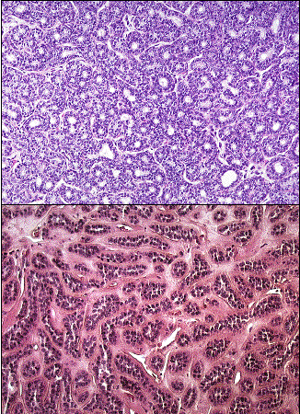
The trabecular- tubular form of basal cell adenoma presents with a distinctive morphology
Trabeculae or solid cords of epithelial cells alternate with ductal or tubular elements composed of two distinctive cell types
The luminal surfaces of the small formed ducts are lined by the cuboidal cells with a minimal amount of cytoplasm
Cuboidal basal cell layer separates the epithelial lining from the stroma

Slide 136
The membranous adenoma differs from other sub types in that it is generally multi lobular and it is encapsulated in 50% of cases
The tumor grows in nodular fashion, with individual nodes often separated by normal salivary gland tissue
Treatment:
Generally the lesions are benign and rarely recur
Membrane form of adenoma demonstrates significant rate of recurrence because of its growth pattern and multi focal nature make complete removal difficult
management is conservative surgical excision including a rim or margin of normally involved tissue

Slide 137
Canalicular Adenoma:
it is a distinctive variant of monomorphic adenoma
The lesion primarily originate in the intra oral accessory salivary gland and in the majority of cases it occurs in the upper lip
The tumor occurs most commonly in patients over 60yrs of age
The tumor generally presents as a slowly growing, well circumscribed, firm nodule which particularly in the lip , not fixed and may be moved through the tissue for some distance

Slide 138
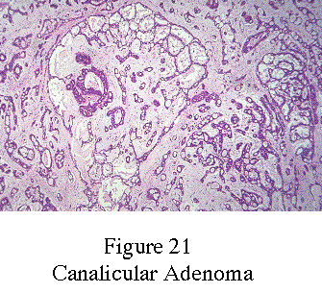
Histologic feature:
the canalicular adenoma has a strikingly
characteristic picture
It is composed of long strands or cords of
epithelial cells, almost invariably arranged
in a double row
In some instances, cystic spaces of varying
sizes are enclosed by the cords
The cystic spaces are usually filled with an eosinophilic coagulum
The supporting stroma is loose and fibrillar with delicate vascularity
Treatment:
the tumor can be treated by enucleation or simple surgical excision, recurrence is rare

Slide 139
MYOEPITHELIOMA
It is a uncommon salivary gland tumor which accounts for less than 1%of all major and minor salivary gland tumors
It occurs in adults with equal sex distribution
The parotid gland is most commonly involved and the palate is most frequent intra oral site of occurrence

Slide 140
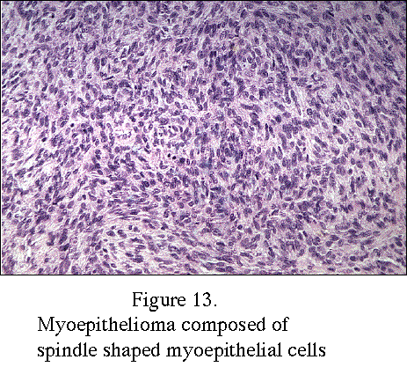
Histologic feature:
it is composed of spindle shaped or plasmacytoid cells or a combination of two of the cells
The cells might be set in a myxomatous back ground which varies from scanty to copious
Definitive diagnosis lies in the ultra structural identification of myoepithelial cells
The myoepithelial cells exhibit a basal lamina and fine intra cytoplasmic filaments, desmosomes are
encountered between adjacent cells

Slide 141
SEBACEOUS ADENOMA
The presence of sebaceous glands has been noted in sub mandibular and parotid salivary glands
This particular tissue thought to originate in intra lobular duct, give rise to sebaceous adenoma and other sebaceous neoplasm
These are rare lesions composed predominantly of sebaceous glands derived cells; they are well differentiated in the benign form and moderate to poorly differentiated in the malignant form
Parotid gland is the site of chief involvement, these lesions may range from a few millimeters to several centimeters in diameter
Parotidectomy is the treatment of choice when lesion arise in the gland , surgical excision is used in case of intra oral neoplasm

Slide 142
ONCOCYTOMA
Also called as oxyphilic adenoma, Acidophilic adenoma..
It is a small benign lesion which usually occurs in the parotid gland, it does not generally attain great size
The name oncocytoma is derived from the resemblance of the tumor cells to apparently normal cells which have been termed to oncocytes and which are found in great number of location, including the salivary glands, respiratory tract, breast, thyroid, pancreas
These cells are seen in ductal lining of glands in elderly persons

Slide 143
Clinical features:
it is more common in women than in men most commonly seen in elderly persons, occasionally these tumor arise before the age of 60yrs
The tumor usually measures 3-5cm in diameter and appears as discrete, encapsulated mass which is some times nodular and pain is generally absent
A condition called diffuse multi nodular oncocytoma or oncocytosis of the parotid gland is characterized by nodules of oncocytes which involve the entire gland or large portion of it

Slide 144
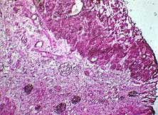
Histologic feature:
it is characterized by large cells which have an eosinophilic cytoplasm and distinct cell membrane and tends to be arranged in narrow rows or cords
These cells occur in sheets and demonstrate an alveolar or lobular pattern
Lymphoid tissue is frequently present but does not appear to be integral part of the lesion
Ultra structural studies of parotid oncocytoma has shown that the cells are engorged with enlarged and morphologically altered mitochondria

Slide 145
A variant of oxyphilic adenoma is some times seen in intra oral salivary glands, particularly in the buccal mucosa and upper lip, this has been termed as oncocytic cyst adenoma
Since it is a tumor like nodule composed chiefly of numerous dilated duct like or cyst like structures lined with oncocytes
Treatment:
surgical excision and the tumor does not tend to recur. Malignant transformation is un common

Slide 146
DUCTAL PAPILLOMA
It is a composite consisting of the sialadenoma papilliferum, inverted ductal papilloma and intra ductal papilloma
Sialadenoma papilliferum is an unusual benign salivary gland neoplasm , a distinct entity of minor and major salivary gland origin
It presents as a painless exophytic papillary lesion
Most cases have been reported in males in fifth and eighth decade of life
It is thought to originate from the superficial portion of the salivary gland excretory duct
Papillary process develop forming convoluted clefts and spaces

Slide 147
Each papillary projection is lined by a layer of epithelium approximately two to three cell layer cell thick and is supported by a core of fibro vascular tissue
The more superficial portion of the lesion demonstrate a Squamous epithelial lining deeper portion show more cuboidal to columnar cells often oncocytic appearance
The behavior of this lesion is benign with no reports of malignant transformation.
management is by conservative surgery; there is little chance for recurrence

Slide 148
A related papillary lesion of salivary duct origin is the inverted ductal papilloma
This is a rare entity of minor salivary gland origin that presents as a nodular sub mucosal mass resembling a fibroma or lipoma, it is seen in adults and has a equal gender distribution.
Intra ducal papilloma is a rare lesion arises deeper from the surface with in the ductal system, often presenting as a salivary obstructive process.
Histologically a single layer or double layer of cuboidal to columnar epithelium covers several papillary folds that project in to a cystic space with no evidence of proliferation in to the wall of cyst.

Slide 149
WARTHIN’S TUMOUR
It is also called as papillary cyst adenoma lymphomatosum, Adenolymphoma
It almost occurs exclusively in the parotid gland, occasional cases had been reported in the sub mandibular gland
The intra oral accessory glands are rarely affected.

Slide 150
Clinical features:
It exhibits a definite predilection for men, seen between the age of 40-70 years with an average duration of symptoms of three years .
The tumor is generally superficial, lying just beneath the parotid capsule or protruding through it.
It seldom attains a size exceeding 3-4cm in diameter it is not painful, is firm to palpation and is clinically in distinguishable from other benign lesions of the parotid gland

Slide 151
Histologic Feature:
This tumor is made up of two histological components: epithelial and lymphoid tissue
As the name indicated that the lesion is essentially an adenoma exhibiting cyst formation, with papillary projection in to the cystic spaces and a lymphoid matrix showing germinal centers
The epithelial cells covering the papillary projections are columnar or cuboidal cells usually arranged in two rows although the inner layer may be several cells thick
These cells are eosinophilic, containing hyper chromatic or pyknotic nuclei and vast number of mitochondria
There is frequently an eosinophilic coagulum present with in the cystic spaces, which appear as a chocolate colored fluid in the gross specimen

Slide 152
The abundant lymphoid component may represent the normal lymphoid tissue of the lymph node within which the tumor developed or it may actually represent a reactive cellular infiltrate which involves both cellular and humoral mechanism.
Treatment:
the accepted treatment of papillary cyst adenoma is surgical excision
These tumors are well encapsulated and seldom recur after removal
Malignant transformation is exceedingly rare in either the epithelial or lymphoid component

Slide 153
Hemangiomas
These are vascular tumors directly involving the parotid and sub mandibular glands.
Two forms of hemangiomas, capillary and cavernous, may develop in the major salivary glands.
The capillary type is the most prevalent tumor of the parotid gland in the first year of life.
Capillary hemangiomas are rapidly growing masses of variable consistency.

Slide 154
These hemangiomas lack a capsule and are formed by purple, spongy, lobular masses that infiltrate salivary gland tissue.
Cavernous hemangiomas, which present in an older age group, rarely show spontaneous regression and present a difficult management problem.

Slide 155
Malignant Pleomorphic Adenoma: (Malignant mixed tumor, Carcinoma ex pleomorphic aenoma)
Occasionally salivary gland tumors occur that appear histologically benign and yet have proved metastasis resembling the primary lesion, or resemble the benign pleomorphic adenoma, but exhibit cytologically malignant areas
It is uncertain whether these tumors represent previously benign lesions which have under gone transformation in to malignant tumors or lesions which were malignant from the onset.

Slide 156
patients with malignant lesion usually give a history of mass which had been present for a number of years, but only recently had shown a remarkably increased growth rate
The majority of cases presented initially as malignant tumors with out a history of sudden rapid growth in long standing tumor

Slide 157
Clinical features:
there are no obvious clinical differences between the benign and the malignant pleomorphic adenoma in many instances
the malignant tumors are usually larger than the benign ones
There is often fixation of the malignant tumor to under lying structures as well as mucosa
Pain is more frequently a feature in the malignant than in the benign pleomorphic adenoma

Slide 158
Adenoid Cystic Carcinoma:
Adenoid cystic carcinoma (ACC) is an uncommon form of malignant neoplasm that arises within secretory glands, most commonly the major and minor salivary glands of the head and neck. Other sites of origin include the trachea, lacrimal gland, breast, skin, and vulva.
The palatal mucosa is the most frequent site of occurrence

Slide 159
Clinical features:
it occurs most commonly in fifth and sixth decade of life.
Many of the patients exhibit clinical manifestations of a typical malignant salivary gland tumor.
Early local pain, facial nerve paralysis in the case of parotid tumors, fixation to the deeper structure and local invasion
Some of these lesions, particularly the intra oral ones exhibit surface ulceration

Slide 160
Histologic feature:
the adenoid cystic carcinoma is composed of small , deeply staining uniform cells resembling basal cells that are commonly arranged in anastomosing cords or a dust like pattern, the central portion of which may contain mucoid material, producing the typical honey comb or swiss cheese patterns .
Characteristically the stromal connective tissue becomes hyalinized and surrounds the tumor cells forming a structural pattern of cylinders from which the lesion derived the name “Cylindroma”

Slide 161
Growth of cells in a solid form some time occurs and there may be typical glandular pattern
Spread of the tumor cells along the perineural spaces or perineural sheaths is a common feature of this neoplasm
It is of interesting that despite the malignant nature of the neoplasm mitotic activity is rare

Slide 162
Treatment and prognosis:
surgery, in some cases surgery has been successfully coupled with x- ray radiation
Radiation alone is not recommended
In general the tumor is a slow growing lesion which tends to metastasize only late in course
Cervical node involvement eventually occurs in about 30% of the cases, distant metastasis to lung, bones and brain occur in a high proportion of the patient
Factors influencing prognosis are the site of occurrence and the histologic pattern of the tumor

Slide 163
Central Muco epidermoid Carcinoma of the Jaw:
The majority of these lesions have occurred in the mandible, although a few have developed in the maxilla; in most cases
The lesions occurred in premolar, molar area and did not extend anteriorly beyond the pre molar region
Several theories have been advanced to account for the occurrence of these lesions with in the jaws

Slide 164
It has been suggested that it may originate from
1) entrapment of retro molar mucous glands with in the mandible, which subsequently under go neoplastic transformation
2) Developmentally included embryonic remnants of the sub maxillary gland with in the mandible
3) Neoplastic transformation of the mucous secreting cells commonly found in the epithelial lining of dentigerous cyst associated with impacted third molars

Slide 165
Staging For Major Salivary gland tumors:
T_{x} Primary Tumor Cannot be assessed
T_{o} No evidence of primary tumor
T₁ Tumor < 2cm in greatest dimension
T₂ Tumor 2-4cm in greater dimension
T₃ Tumor 4-6cm in greater dimension
T₄ Tumor > 6cm in greatest dimension
All categories are sub divided: (a) no local extension, (b) local extension
Local extension is clinical/ macroscopic invasion of skin; soft tissue, bone or nerve
Microscopic evidence alone is not considered local extension for classification purpose

Slide 166
N_{x} Regional node cannot be assessed
N_{o} No regional lymph node metastasis
N₁ Single ipsilateral lymph node metastasis
N_{2a} Single ipsilateral node < 3cm in diameter
N_{2b} Multiple ipsilateral node, none >6cm
N_{2c} Bilateral or contra lateral nodes, none >6cm
N₃ Metastasis in a lymph node >6cm
M_{x} Presence of distant metastasis cannot be assessed
M_{o} No distant metastasis
M₁ Distant metastasis

Slide 167
Stage I: T1a No Mo
T2a No Mo
Stage II: T1b No Mo
T2b No Mo
T3a No Mo
Stage III: T3b No Mo
T4a No Mo
Any T (except T4b) N1 Mo
Stage IV: T4b Any N Mo
Any T N2 N3 Mo
Any T Any n M1

Slide 168
Thank u

Slide 169
IMAGING OF SALIVARY GLANDS
Plain film radiography
Intra oral radiography
Extra oral radiography
Sialography
Scintigraphy
CT
MRI
Ultrasound.

Slide 170
Plain film radiography :
Important & fundamental part of the examination of salivary glands.
To examine the well calcified salivary gland stones.
It is recommended to use about half of the usual exposure to avoid overexposure of the sialoliths.

Slide 171
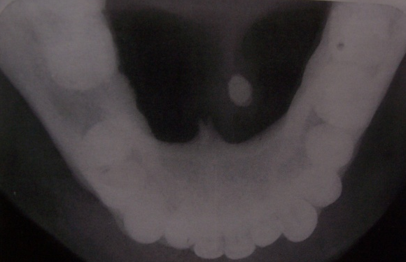
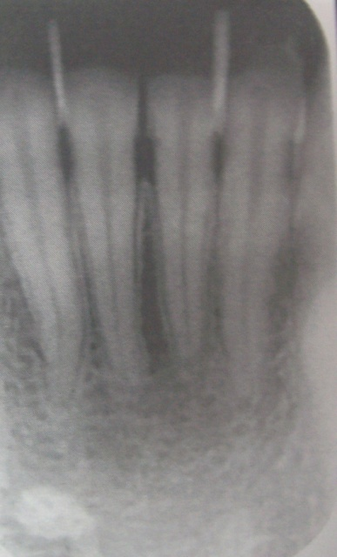
Intra oral radiography :
Stone in the anterior 2/3rd of submandibular duct are imaged with a cross sectional mandibular occlusal projection.
Posterior part of the duct is demonstrated with a posterior oblique view.
Stone in anterior part of the parotid duct is imaged on Intra oral film. Film is held with hemostat against the cheek, as high as possible in the buccal sulcus & over the parotid papilla.The central ray is directed perpendicular to the centre of film.

Slide 172
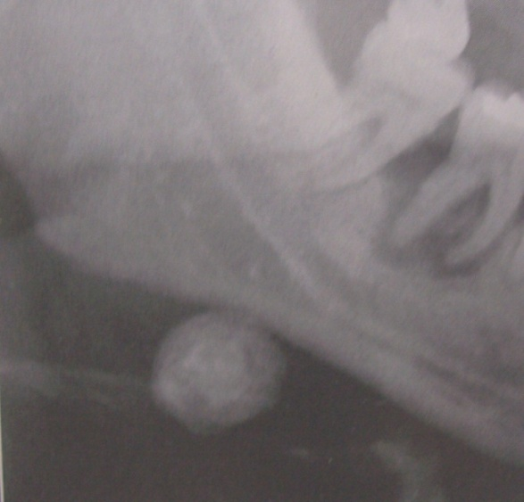
Extra oral radiography :
Panoramic radiographs shows stones while superimposed over the ramus & body of the mandible.
To demonstrate stones in the submandibular gland a lateral projection is made by opening the mouth, extending the chin & depressing the tongue with the index finger. This will move the stone inferiorly a image will be apparent.
Stone in the distal portion of parotid gland is demonstrated by posteroanterior view projection with
cheeks puffed out may move the stone free
of bone.

Slide 173
Commonly used radiographic projections for Salivary glands
Salivary gland | Radiographic projection used
parotid | OPG, Oblique lateral, Rotated PA or AP, intraoral view of cheek
submandibular | OPG, Oblique lateral, lower occlusal oblique view, lateral skull with tongue depressed.

Slide 174
Sialography :
First mentioned by Carpy in1902 & described as a diagnostic tool by Barsony in 1925.
It is radiographic technique in which a radiopaque contrast agent is infused into the ductal system of salivary gland prior to imaging with plain films, fluoroscopy, panoramic radiography, computed radiography.
Sialography provides a straight forward demonstration of the ductal system.
The parotid & submandibular gland are more commonly studied with this technique.

Slide 175
A survey film is usually made prior to introduction of the contrast solution into the ductal system, helps to decide the positioning of patient & exposure parameters.
Lacrimal or periodontal probe is used to dilate the ductal orifice. Then a cannula is connected to a syringe containing contrast agent.
Contrast agent is slowly infused until the patient feels discomfort ( usually 0.2 to 1.5ml ).

Slide 176
Radiograph is taken.
Gland is allowed to empty for 5 min without stimulation, if there’s contrast retention lemon juice or 1% citric acid is administered to stimulate secretion.

Slide 177
Procedure is divided into 3 phases
Preoperative phase
Filling phase
Emptying phase

Slide 178
Preoperative phase
To note the position &/or presence of any radiopaque obstruction.
To assess the position of shadows cast by normal anatomic structures that may overlie the gland such as hyoid bone.
To assess the exposure factors.

Slide 179
Filling phase
Three main techniques for introducing contrast medium are
Simple injection technique
Advantages
Simple & inexpensive
Disadvantages
The arbitrary pressure that is applied may cause damage to the gland.
May lead to underfilling or overfilling of gland

Slide 180
Hydrostatic phase
Advantages
Controlled introduction of contrast medium cause less damage
Simple & inexpensive
Disadvantages
Patient have to lie down during the procedure.

Slide 181
Continuous infusion pressure-monitored technique.
Advantages
Controlled introduction of contrast medium cause less damage.
Does not cause overfilling of gland.
Disadvantages
Complex equipment required
Time consuming

Slide 182
Contrast media
All contrast media used are iodine based & are classified into oil based & water based solutions.
Water based media
Diatrizoate (Urografin)
Metrizoate (Triosil)
Oil based media
Lipiodol (iodised poppy seed oil)
Pantopaque (Water insoluble organic iodine compounds)

Slide 183
Indications & contraindications
Indications
To determine the presence & /or position of calculi or other blockages.
To assess the extent of ductal & glandular destruction secondary to an obstruction
To assess the extent of glandular breakdown.
To assess the functions in case of dry mouth.
To determine the location, size, nature, & origin of swelling or mass.

Slide 184
Contraindicatons :
Acute infection / inflammation
Allergic to iodine containing compounds.
Stones close to ductal orifice may be pushed back as contrast media is injected.

Slide 185
Sytematic approach for sialographic interpretation
Note the shadows cast by overlying anatomic structures:
The HYOID or SPINE or MANDIBLE
Assess the exposure factors
Assess the degree of filling the duct structures
Assess the main duct for diameter, course & direction , presence of filling defect
Assess the degree of emptying

Slide 186
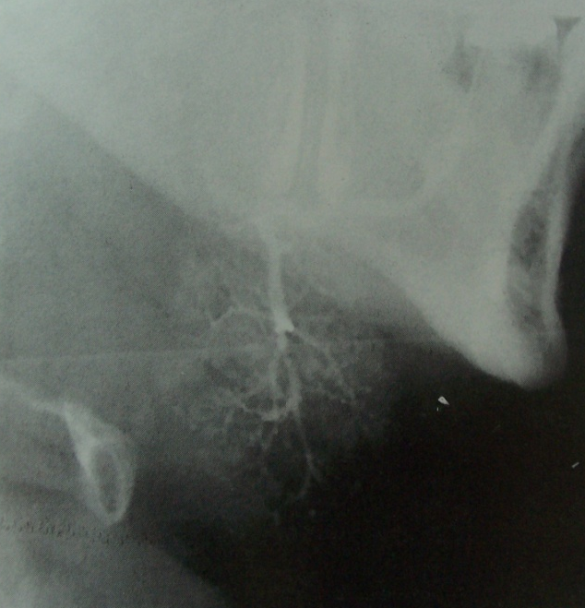
Normal sialographic appearances of salivary glands.

Slide 187
sialographic appearances of sialodochitis – sausage link appearance.
sialographic appearances of sialadenitis – sialectasis
sialographic appearances of Sjogren’ s sydrome – punctuate sialectasis or snowstrom appearance.
sialographic appearances of intrinsic tumours – ball in hand appearnce.

Slide 188
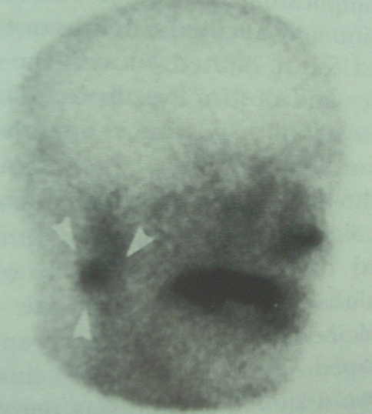
Scintigraphy :
This technique provides a functional study of the salivary glands.
10-20 millicuries of the radioactive isotope is injected intravenously .
Uptake, concentration & excretion is recorded by using a gamma scintillation camera.
Photographs are taken every 2 min for first 10 min & then every 10min for 1 hr.

Slide 189
SS patients demonstrates :
Decreased uptake ( cold spots ) because of atrophy & fibrosis of the glandular tissue.
Following the secretory phase there may be secondary retention images ( hot spots ) in dilated ducts & abscess cavities.
Majority of benign tumors demonstrates cold spots.
Warthins tumor & oncocytoma shows hot spots.
Dental obstruction resulting in hot spots

Slide 190
Cherry blossom appearance in SS

Slide 191
Acute sialadenitis:
Sialography is contraindicated in acute infections.
Ultrasound may distinguish inflammation & suppuration.
Can detect stone atleast 2mm in diameter.
MRI, CT & scintigraphy are not likely to provide any useful information.

Slide 192
Chronic sialadenitis:
Sialography is helpful in locating obstructions that were not detected with plain radiography.
Ductal dialation can be seen.
Sialography should not be proposed if a radiopaque stone has been shown by plain radiography because the procedure may displace it proximally into the ductal system which might complicate it subsequent removal.
In chronic recurrent sialadenitis sausage string appearance of the main duct.
CT, MRI & scintigraphy are not typically indicated in diagnosis of inflammatory disease.

Slide 193
Autoimmune sialadenitis :
Sialography is helpful in the diagnosis & staging of autoimmune disorders.
Punctate (smaller than 1mm )
Globular (1-2 mm ) Sialectasis
Cavity (greater than 2mm in dia )
Intraglandular duct is not present.
Main duct is not affected.

Slide 194
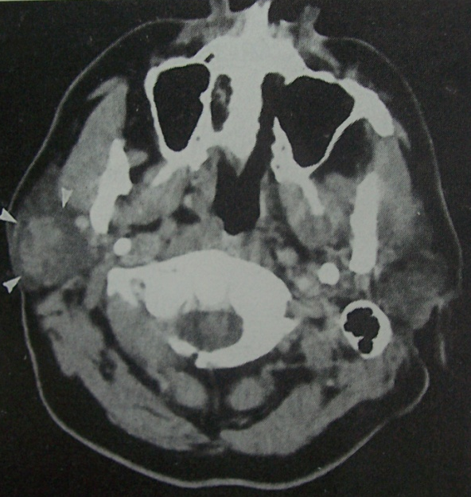
Scintigraphy is useful for diagnosing & monitoring the progression of sjogren’s syndrome.
CT, MRI & ultrasonography are not particularly diagnostic for autoimmune disorders of salivary glands.
Tumors :
Salivary gland tumors are well
appreciated in CT & MRI.

Slide 195
SALIVARY GLAND NEOPLASMS
Benign Neoplasms
Pleomorphic Adenoma
-CT:
-well-circumscribed mass with homogeneous or heterogeneous density
-contrast enhancement varies but tends to be mild
-calcifications may be evident
-MRI:
-predominantly heterogeneous well-circumscribed mass
-T1 intermediate to low signal intensity
-T2 increased signal

Slide 196
Warthin Tumour and Oncocytoma
-CT:
-homogeneous well-circumscribed mass
-hypodense or cystic areas
-calcification does not occur
-MRI:
-T1 intermediate to low signal intensity
-T2 increased signal
-both Warthin and oncocytoma are unique in that they accumulate technetium-99m pertechnetate

Slide 197
Hemangioma and Lymphangioma
-plain film: may demonstrate calcification of multiple phleboliths within tumour
-CT: well-defined heterogeneous mass
-MRI: heterogeneous signal on T1 and T2
Lipoma
-may be intraparotid or paraparotid
-CT: low attenuation (-50 to -150 HU)
-MRI: high signal T1; intermediate signal T2

Slide 198
Malignant Neoplasms
Mucoepidermoid Carcinoma
-low-grade MEC has CT and MRI characteristics resembling benign lesions
-well circumscribed and regularly marginated without infiltration into adjacent soft tissues
-low to intermediate signal intensity on T1 with increasing intensity on T2
-high-grade MEC:
-more irregular appearance with irregular margination and infiltration into soft tissues
-signal intensity intermediate on T1 and T2

Slide 199
Adenoid Cystic Carcinoma
-perineural infiltration common
-CT signs of perineural involvement:
-obliteration of normal fat plane beneath stylomastoid foramen
-tumour enhancement along course of facial nerve
-vascular enhancement with variable infiltration into adjacent soft tissues
-recurrent disease demonstrates CT enhancement and increased signal on T2 weighted images

Slide 200
Advantage of Ultrasound
Sound waves are not ionizing radiation.
There are no known harmful effects on any tissues at energies & doses currently used in diagnostic ultrasound.
Images show good differentiation between soft tissues.
Technique is widely available inexpensive, non invasive, pain less

Slide 201
Disadvantages of Ultrasound
Real-time imaging means that the radiologist must be present during the investigation.
Technique is operator dependent.
If the lesion is very deep or surrounding bone is very thick, ultrasound waves are absorbed by bone.

Slide 202
CT & MRI
For evaluating salivary gland pathology, adjacent stuctures, the proximity of the lesion to facial nerve.
Osseous erosions & sclerosis are better seen in CT than MRI.
CT is helpful in evaluating inflammatory conditions associated with sialoliths, abscesses, cystic masses, neopalsias.
Non enhanced & enhanced CT are used routinely.
Thin axial & coronal images are acquired.

Slide 203
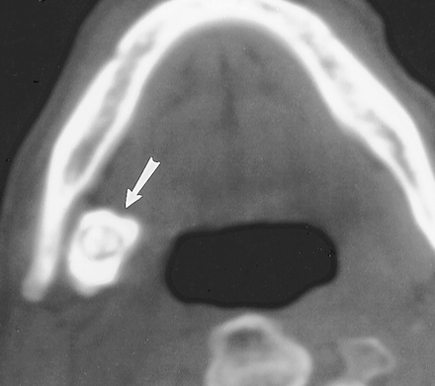
CT scan of glandular calcification

Slide 204
Advantages of CT
Accurate location of the masses espeially in deeper portions of glands.
Visualise masses that are poorely defined on MRI.
Better Visualisation of osseous structures.
Distinguishes abscesses from cyst (nature of lesion often determined)
Images can be enhanced by using contrast media.
Disadvantages of CT
Radiation exposure
Potential scatter from dental restorations.
Use of iodine contrast medium for enhancement.
No information regarding function.

Slide 205
Advantages of MRI
Excellent ability to differentiate soft tissues.
Ability to provide multiplanar imaging.
Evaluate adjacent structures & proximity of facial nerve.
No radiation exposure
No IV contrast used routinely
No artifact from dental restoration.
Disadvantages of MRI
Only soft tissue imaging.
no information regarding function.

Slide 206
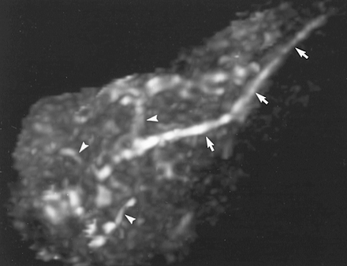
MRI sialography in normal individual

Slide 207
References
Burket’s Oral Medicine . Diagnosis & treatment. 9th, 10th & 11th edition.
Text book of oral pathology .Shafers 5th edition.
Oral & Maxillofacial pathology. Neville 2nd edition.
Oral pathology .Regezi & Scuibba.4th edition.
Malignant tumours of mouth, jaws, & salivary glands. Langdon & Henk. 2ND edition.
Oral manifestations of systemic diseases. Mason 2nd edition.

Slide 208
Oral diseases clinical & pathological correlations . Cawson & Binnie 2nd edition.
Essentials of Oral Medicine .Silverman & Eversole.
Primary SS : Subjective symptoms & salivary findings. JOPM 1999 ;28:303-11.
Sialochemistry in SS-a review. JOPM
The person behind the eponym Sjogren’s syndrome. JOPM 1998.
Essential of dental radiography & radiology. Eric whaites 2nd edi.

Slide 209
Thank u

